Slide 1




Gambling II
Produced by Dr. Mario
UNC STOR 538

Slide 2


Rating sports teams
Expected Profit of Gambler for Bet on Spread
Assume P(Win)=P(Loss)=0.5
Expected Profit for Bettor
Percent of Bets Needed to Win to Break Even
We Need to Win 52.4% of the Bets on Spread to be Even
Power Ratings
Bookmakers Use Ratings to Set Point Spreads
Example: Panthers +1 and Browns -12
This Can Be Adjusted for Home Edges
$$E\left[Profit\right]=(\$10)\left(0.5\right)−(\$11)\left(0.5\right)=−\$0.50$$
$$p=0.524$$
$$E\left[Profit\right]=(\$10)\left(p\right)−(\$11)\left(1−p\right)=0$$
$$E\left[Spread\right]=1 −(−12)=13$$

Slide 3
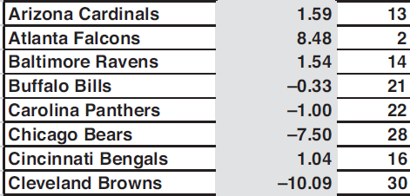
Rating sports teams
Spreads from Power Rankings Are Usually “Fair”
Example of Power Ratings from 2016
Why Not Use Team Rank for Rating?
Not Last

Slide 4
Rating sports teams
Ideal Team Ratings
Average Team Represented by 0
Expressed in Units of Points
Example: Expect Panthers to be 1 Point Worse Than Average Team Would Mean Their Rating is -1
Methodology in 6 Steps
Step 1: Randomly Attempt to Give Trial Ratings for Each Team and Randomly Establish the Home Edge
Step 2: Get Actual Game Data
Step 3: Determine Actual Margin of Victory
$$Margin=Home Points −Away Points$$

Slide 5
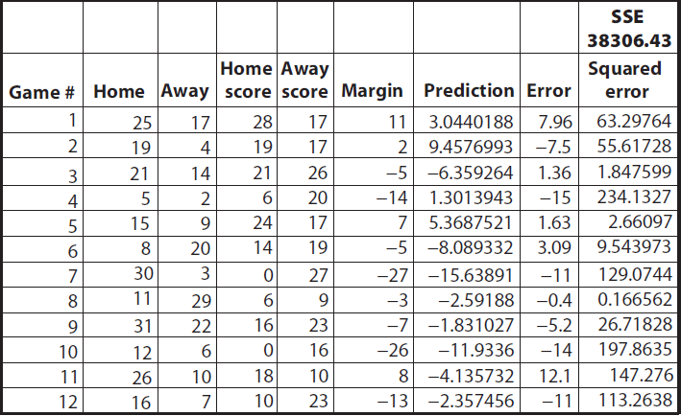
Rating sports teams
Methodology in 6 Steps
Step 4: Predict Margin From Ratings
Step 5: Compute Errors from Prediction
$$E\left[Margin\right]=Home Edge+Home Rating −Away Rating$$
$$Error=Margin −E[Margin]$$
Minimize This

Slide 6

Rating sports teams
Methodology in 6 Steps
Step 6: Find Optimal Team Ratings to Minimize SSE
EXCEL Solver
optim() Function in R
Alternative: Use Basic Regression
$$Margin=β_{o}+X\overset{⃑}{β}$$
$$X=\left[\begin{matrix}1 & −1 & ⋯ & 0 & 0 \\ 0 & −1 & ⋯ & 1 & 0 \\ ⋮ & ⋮ & ⋱ & ⋮ & ⋮ \\ 1 & 0 & ⋯ & 0 & −1\end{matrix}\right]$$
Home
Edge
Home
Away

Slide 7
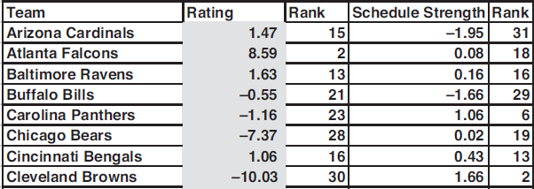
Rating sports teams
Strength of Schedule
Average the Ability of All Opponents
Example from 2016
Using Mean Absolute Error
Games With Unusual Spreads Are Outliers
Median Minimizes Mean Absolute Error
Power Ratings Less Impacted by Outliers

Slide 8
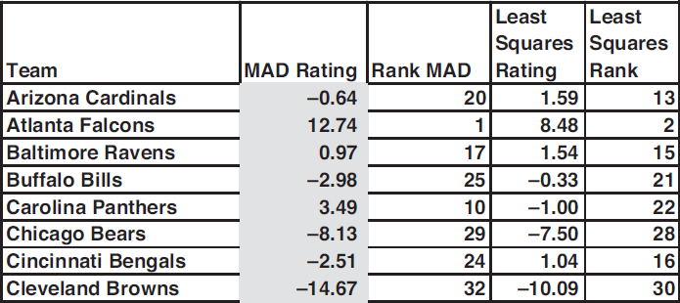
Rating sports teams
Comparison
Offensive/Defensive Ratings
Related to the Over/Under
Offensive Rating = Ability to Score Points
Positive = Scores More Points Than Average
Negative = Scores Less Points Than Average
Defensive Rating = Ability to Stop Scoring
Positive = Gives Up More Points Than Average
Negative = Gives Up Fewer Points Than Average
Now the Clowns Are Last

Slide 9
Rating sports teams
Offensive/Defensive Ratings
Predicted Points Scored by Home Team
Predicted Points Scored by Away Team
Divided Up Home Edge Equally
Average = Average Number of Total Points
Can Be Used to Create Overall Rating
Use These to Predict Team Points
Add Expected Home Points and Expected Away Points to Estimate Over/Under
$$Average+0.5\left(Home Edge\right)+Home Off. Rating+Away Def. Rating$$
$$Average−0.5\left(Home Edge\right)+Away Off. Rating+Home Def. Rating$$
$$Team^{′}s Off. Rating−Team^{′}s Def. Rating$$

Slide 10
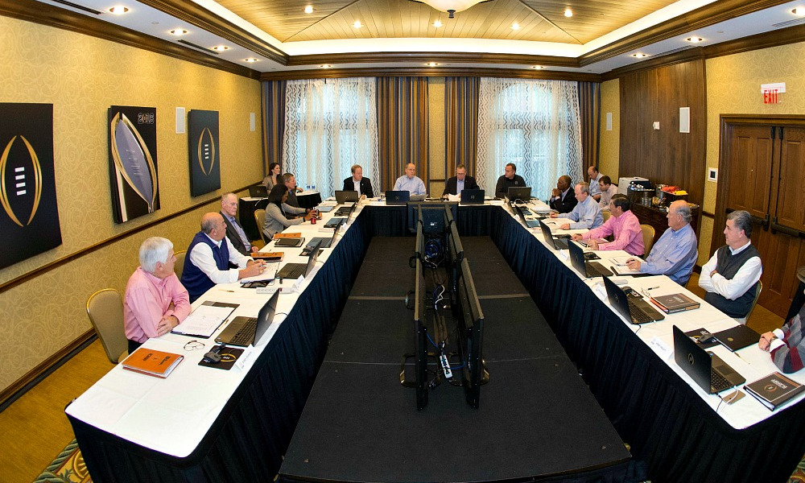
Rating sports teams
Ranking Based on Wins and Losses
Controversy in College Football
Choosing Top Teams for College Football Playoffs
Overall Record
Strength of Conference
Strength of Out-of-Conference Schedule
Head-to-Head Competition
Comparative Outcomes of Common Opponents
Conference Championships
Used to Be Chosen by Computer
Now Chosen by Committee
Problem with Considering Game Scores?

Slide 11
Rating sports teams
Ranking Based on Wins and Losses
Using Team Ratings to Estimate the Probability of Winning
Let p Represent the Probability the Home Team Wins
Use Logistic Regression to Estimate p
Not Minimizing Least Squares but Maximizing Likelihood
Home Rating = Impact the Home Team Has on Winning Game
Away Rating = Impact the Away Team Has on Winning the Game
Can Be Used to Predict Head-to-Head Games
Problem Considering Wins/Losses?
$$p=\frac{e^{home rating − away rating + home edge}}{e^{home rating − away rating + home edge}+1}$$

Slide 12
Rating sports teams
Rating Method by Fivethirtyeight
Utilizes Elo Rating for Sports
Elo Rating Popularized in Chess
Judges Teams/Players From Head-to-Head Results
Fivethirtyeight Uses Elo Ratings to Forecast Outcomes
Elo in NFL
Every Team Has a Power Rating
Average is 1500
Winner Gains Points Equal to the Points Lost by the Loser
Formula for Odds of Team Winning
$$P\left(A\right)=\frac{1}{{10}^{−\frac{EloDiff}{400}}+1}$$

Slide 13
Rating sports teams
Rating Method by Fivethirtyeight
EloDiff is Based On a Few Things
Difference Between Team Ratings
Home Edge Adjustment Scaled by Distance Traveled
Rest Adjustment for Teams Coming Off a Bye Week
Playoff Adjustment (Favorites Tend to Dominate Underdogs)
Quarterback Adjustment (Due to Importance of this Position)
Dividing EloDiff by 25 Has Been a Good Estimate of Spread
Winning Team Gains Points Based on a Few Things
K-factor = Regulates How Quickly Ratings Change
Forecast Delta = Difference Between The Result and
Predicted Probability
Margin of Victory Multiplier

Slide 14

Final Inspiration
If you don’t remember history,
you won’t know if you repeat it.
-Mahatma Mario

